Slide 1
IMAGES AND GRAPHICS
B. Okuku

Slide 2
An image is a spatial representation of an object, a two-dimensional or three-dimensional scene or another image. Often the images reﬂect the intensity of lights.
Most photographs are called continuous-tone images because the method used to develop the photograph creates the illusion of perfect continuous tone throughout the image.
Images stored and processed by computers, displayed on computer screens, are called digital images although they often look like continuous-tone. This is because they are represented by a matrix of numeric values each represents a quantised intensity values.
B. Okuku

Slide 3
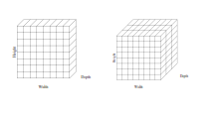
Basic Concepts
The smallest element on a digital image is known as a pixel — a picture element. A digital image consists of a (usually rectangular) matrix of pixels.
B. Okuku

Slide 4
Depth.
The depth of an image is the number of bits used to represent each pixel.
1-bit black-and-white image, also called bitmap image.
4-bit can represent 16 colours, used in low
resolution screens(EGA/VGA)
8-bit can have 256 colours. The 256 colour images are often known as indexed colour images. The values are actually indexes to a table of many more
different colours. For example, Colour 3 is mapped to (200, 10, 10).
8-bit grey 256 grey-levels. The image contains only brightness/intensity data without colour information.
B. Okuku

Slide 5

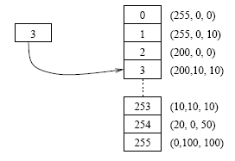
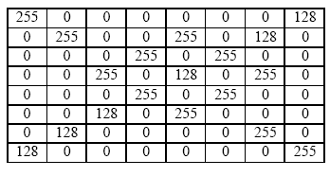
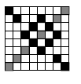
B. Okuku

Slide 6
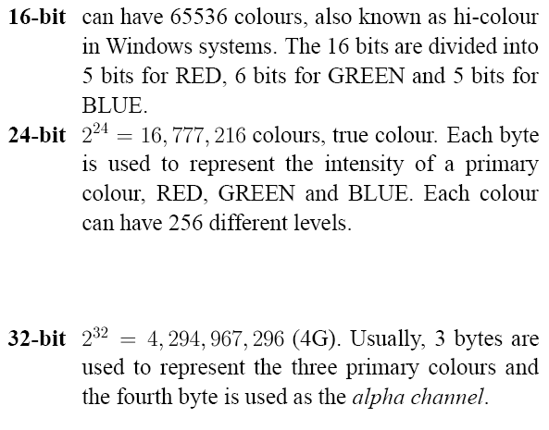
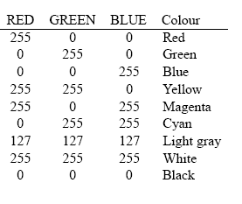
B. Okuku

Slide 7
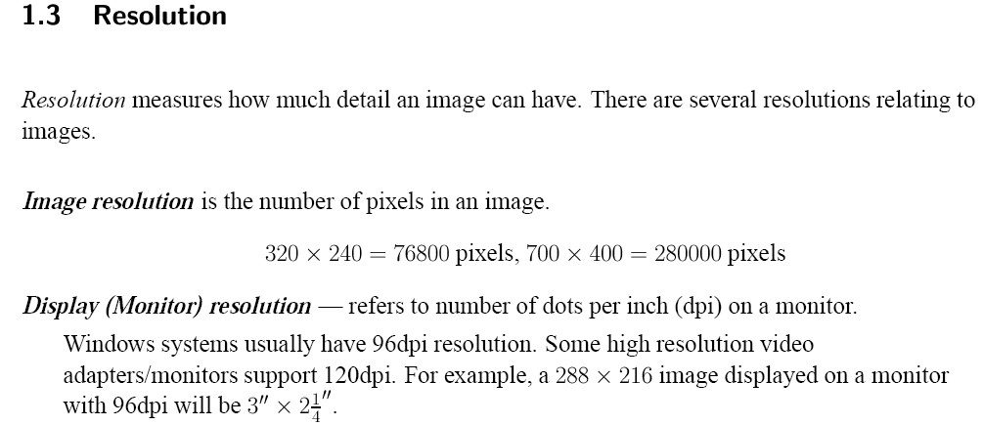
B. Okuku

Slide 8
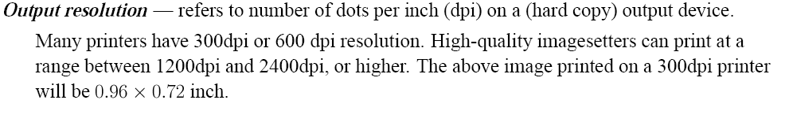
B. Okuku

Slide 9
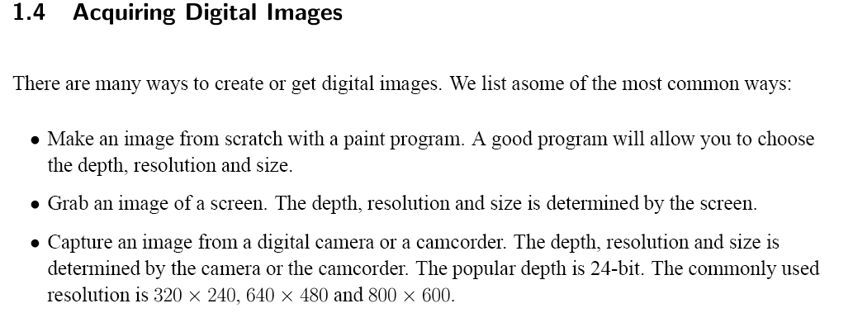
B. Okuku

Slide 10
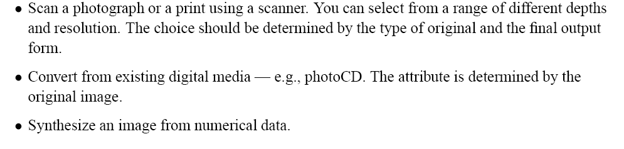
B. Okuku

Slide 11
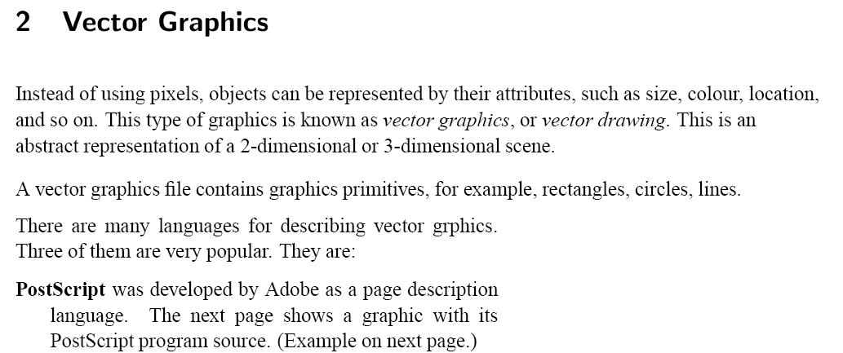
B. Okuku

Slide 12
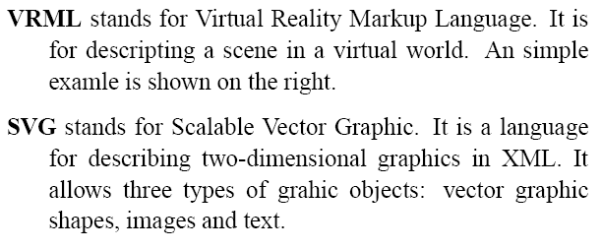
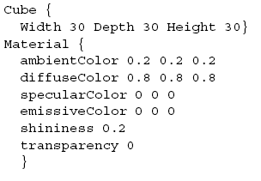
B. Okuku

Slide 13
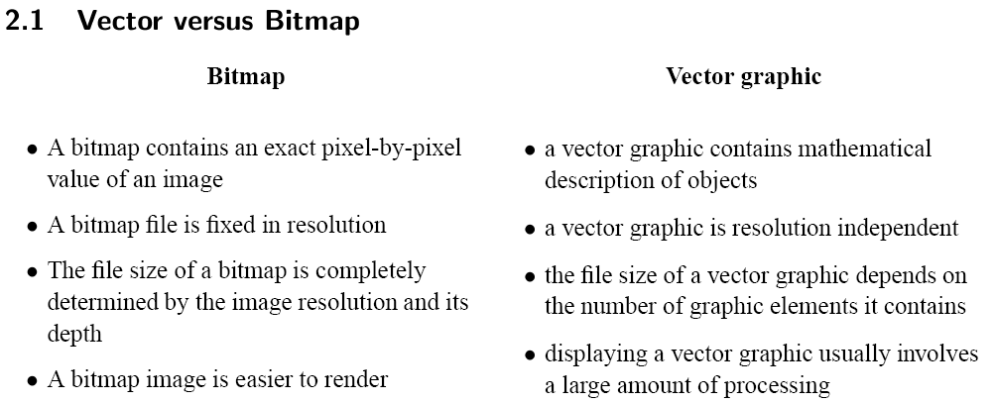
B. Okuku

Slide 14
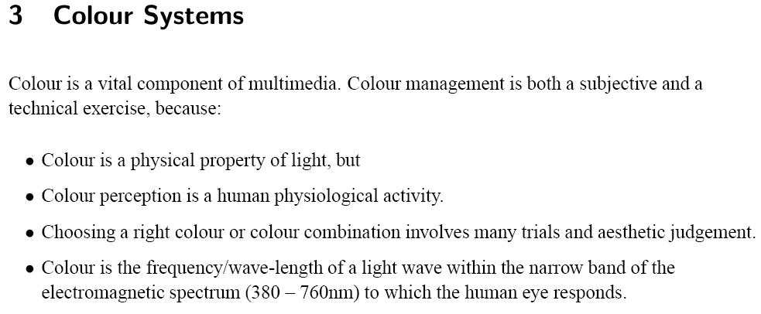
B. Okuku

Slide 15
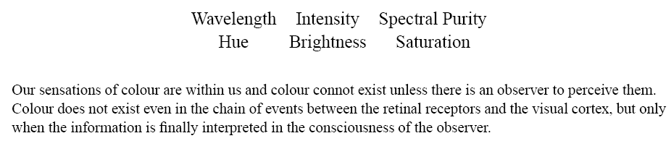
B. Okuku

Slide 16
3.1 RGB Colour Model
This is probably the most popular colour model used in computer graphics.
It is an additive system in which varying amount of the three primary colours, red, green and blue, are added to black to produce new colours.
You can imagine three light sources of the primary colours shine on a black surface. By varying the intensity of the lights, you will produce different colours.
B. Okuku

Slide 17
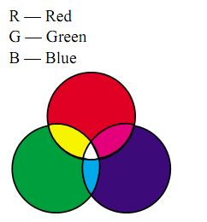
B. Okuku

Slide 18
3.2 CMY Colour Model
This model is based on the light absorbing quality of inks printed on paper. Combining three primary colour pigments, Cyan, Magenta and Yellow, should absorb all light, thus resulting in black.
It is a subtractive model.
The value of each primary colour is assigned a percentage from the lightest (0%) to the darkest (100%).
Because all inks contain some impurities, three inks actually produce a muddy brown, a black colour is added in printing process, thus CMYK model.
Note: the primary colours in RGB and CMY models are complementary colours.
B. Okuku

Slide 19
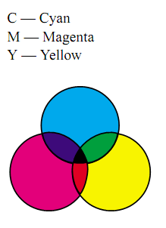
B. Okuku

Slide 20
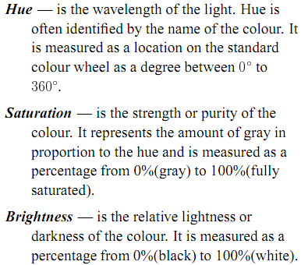
This model is based on the human perception of colour.
The three fundamental characteristics of colours
are:
B. Okuku

Slide 21
3.4 YUV Colour Model
This model is widely used in encoding colour for use in television and video.
The theory behind this model is that human perception is more sensitive to brightness than any chrominance information, so a more suitable coding distinguishes between luminance and chrominance. This also produces a system that is compatible with black-and-white TV systems.
The Y-signal encodes the brightness information. Black-and-white television system will use this channel only.
The U and V channels encode the chromatic info. The resolution of the U and V channels is often less than the Y channel for the reason of reducing the size.
B. Okuku

Slide 22
3.5 Gamut
The gamut of a colour system is the range of colours that can be displayed or printed. The spectrum of colours that can be viewed by human eye is wider than any method of reproducing colour.
Different colour models have different gamut. The CMYK model is smaller than RGB model. On the right is a Chromaticity Diagram which illustrates gumat of RGB and CMYK colour systems.
B. Okuku

Slide 23
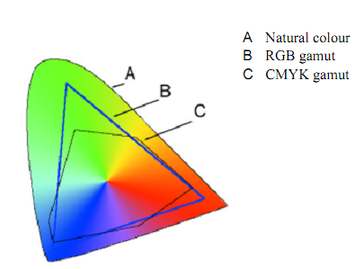
B. Okuku

Slide 24
3.6 Colour Palette
A colour palette is an index table to available colours in an indexed colour system. When working in 8-bit mode, a system can display only 256 colours out of a total of 16 million colours. The system keeps a default palette of available colours.
B. Okuku

Slide 25
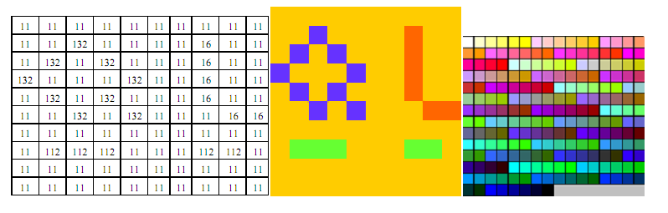
B. Okuku

Slide 26
Palette ﬂashing.
Each program may have its own palette. It may replace the system palette with its own for the period it is active. This may cause an annoying ﬂash of strange colours in your screen, known as palette ﬂashing. This is a serious problem in multimedia applications.
B. Okuku

Slide 27
4 Some Image Techniques
4.1 Dithering
Dithering is a technique to increase the number of colours to be perceived in an image. It is based on human eye’s capability for spatial integration, that is, if you look at a number of closely placed small objects from a distance, they will look like merged together.
Dithering technique groups a number of pixels together, say 4, to form a cluster. When viewed from sufﬁcient distance, the individual pixel will not be distinguishable. The cluster will look like a single block of a colour different from the individual pixel.
B. Okuku

Slide 28
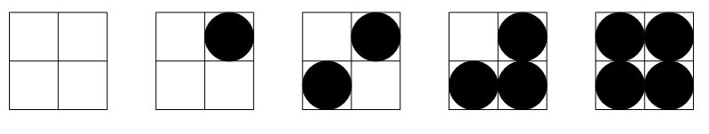
B. Okuku

Slide 29
4.2 Anti-aliasing
Aliasing is caused by the limited resolution of an output device. Aliasing makes edges seen as staircases.
Anti-aliasing is a technique to reduce the staircase effect. It works by ﬁlling in pixels which should be half ﬁlled with different levels of gray or matching colours. The result is sharper edges, not blurring or smoothing them.
B. Okuku

Slide 30
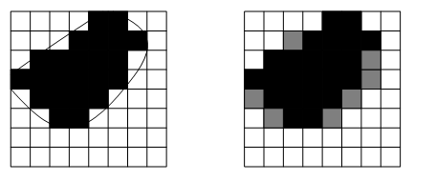
B. Okuku

Slide 31
5 Image And Graphics File Formats
A digital image is stored in a ﬁle conforming to certain format. In addition to the pixel data, the ﬁle contains information to identify and decode the data:
The format
The image size
Depth
Colour and palette
Compression
B. Okuku

Slide 32
Some formats are deﬁned to work only in certain platform while other can be used for all
platforms. Some formats are speciﬁc for an application. Some formats are for images, others are for vector graphics. Some formats allow compression, others contain only raw data.
Note: Formats using compression will make the ﬁle size smaller. Some compression algorithms will lose some image information.
B. Okuku

Slide 33
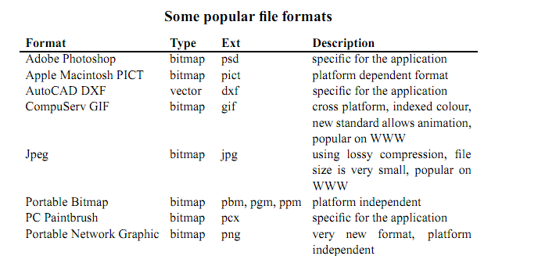
B. Okuku

Slide 34
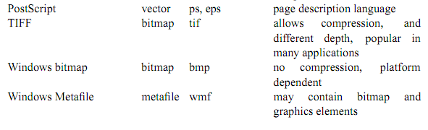
B. Okuku

Slide 35
6 Digital Image Processing
This is a very large area containing the following sub-areas:
Image analysis is concerned with techniques for extracting descriptions from images that are
necessary for higher-level scene analysis methods.
Image recognition is concerned with the techniques for recovering information about objects in the image. A sub-area is character recognition.
Image enhancement is concerned with the technique to improve the image and to correct some
defects, such as, colour and tonal adjustment, Transformations, e.g., scale, rotate, Special effects, e.g., texture, stylize, blur, sharpen.
B. Okuku

Slide 36
7. Image And Graphics Software
Image editing and processing tools, such as
Windows Paint— simple
Adobe Photoshop
Macromedia Firework
MetaCreation Painter
Corel PhotoPaint
Paint Shop Pro— a low cost shareware
The GIMP— an open source program with excellent functions
B. Okuku

Slide 37
Vector graphics tools, such as
Adobe Illustrator
Macromedia Freehand
Corel Draw
Format conversion tools— Many applications can open/import ﬁles in various formats and
save/export to another format. Paint Shop Pro can understand ﬁles in a very large number of
formats.
B. Okuku

Slide 38
8 Exercises
1. A bitmap image has resolution 640*480 pixels. Each pixel is 24-bit deep. What is the size of the bitmap in bytes.
2. A photograph of 3*2 inches is to be scanned. It will be used in a multimedia application in which the image will be displayed on screen. Hardcopy may be printed on a 300dpi laser printer if the user wants. The size of the hardcopy should be 4*2 2/3 inches. What is the best resolution to be used in scanning?
B. Okuku

Slide 39
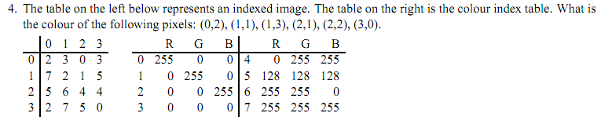
3. A photograph of 3*4 inches is scanning in 300dpi resolution and 8-bit colour. The image is then saved in a jpeg ﬁle with 1:20 compression ratio. It is used on a web page. If a viewer connecting to the Internet using a modem with typical transfer rate of 800 bytes/sec, how long will it take to download the image to his/her computer?
B. Okuku

